Slide 1
3D Interactive Media Development
5MMCS001W Lecture 11

Slide 2
3D Interactive Media Development
Unity Camera Prefabs

Slide 3
3D Interactive Media Development
Unity Camera Prefabs
Prefab:
Prefab is a collection of assets and custom scripts that acts as a complete Game Object.It is also useful for using and editing multiple objects.
Just right click to create a Prefab Variant, or drag into Hierarchy, then back for an Original Prefab. You can open and edit Prefabs in the top of the Inspector Window. Note: it is not necessary to create new prefabs for this CW, though it could be an extra.

Slide 4
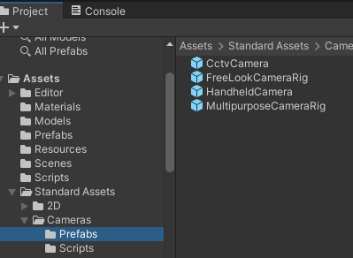
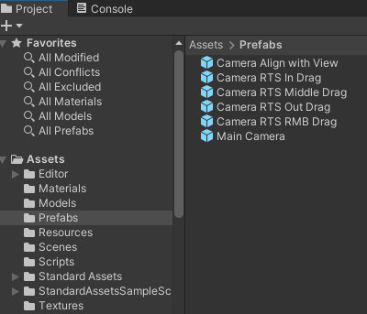
3D Interactive Media Development
Unity Camera Prefabs
In the Camera Prefabs folder are a few Camera Rigs, explained below.
To use them, simply drop one into your scene, and set the target field on the root of the camera rig.
If your player is tagged "Player", you don't even have to assign the target, as by default the cameras will automatically target the first object they find tagged "Player". You can uncheck this option if you don't want it.
After adding one to your scene, you will also probably want to delete the default "Main Camera" that was in your scene already, since the camera rigs contain their own cameras. Note: some of these scenes are just scripts attached to the main camera….

Slide 5
3D Interactive Media Development
Unity Camera Controllers – 3PC, FPC, Other Camera Prefabs
https://www.youtube.com/watch?v=z_mJ_BjFqlU
Unity Project Scenes - Standard Assets: 3PC, FPC, Others
This will be used more for the mouse orbit and waypoint navigation model, if at all.
Comes with Freelook, MouseLook and Mouse Orbit Improved (MOI) scripts.
I include these in Camera Demos SA Project so you do not have to do the complex import.
The FPC and 3PC is advanced and more suited for games (uses Cinemachine as well).
It also comes in a complex range of URP and Non-URP, Standard Assets (old), and Starter Assets (new)

Slide 6
3D Interactive Media Development
Unity Character Controller Prefabs (with Cameras)
Unity Project Scenes – Starter/Standard Assets: 3PC, FPC
Starter Is new and comes only in URP
https://assetstore.unity.com/search#q=starter%20asset
Standard is old and did come in URP and Non URP
https://jimmyvegas.itch.io/first-person-controller-starter-asset

Slide 7
3D Interactive Media Development
Unity Camera (Character) Controllers
Unity Project Scenes – Starter/Standard Assets: 3PC, FPC
The character in a first- or third-person game will often need some collision-based physics so that it doesn’t fall through the floor or walk through walls. Usually, though, the character’s acceleration and movement will not be physically realistic, so it may be able to accelerate, brake and change direction almost instantly without being affected by momentum.
In 3D physics, this type of behaviour can be created using a Character Controller. This component gives the character a simple, capsule-shaped collider that is always upright. The controller has its own special functions to set the object’s speed and direction but unlike true colliders, a rigidbody is not needed and the momentum effects are not realistic.
A character controller cannot walk through static colliders in a scene, and so will follow floors and be obstructed by walls. It can push rigidbody objects aside while moving but will not be accelerated by incoming collisions. This means that you can use the standard 3D colliders to create a scene around which the controller will walk but you are not limited by realistic physical behaviour on the character itself.

Slide 8
3D Interactive Media Development
Unity Camera (Character) Controllers
Unity Project Scenes - Standard Assets: 3PC, FPC
3PC – Third Person Character Controller
FPC – First Person Controller

Slide 9
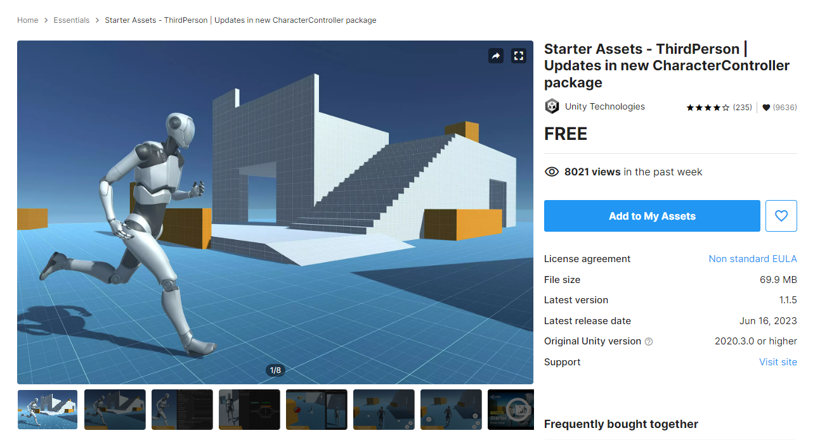
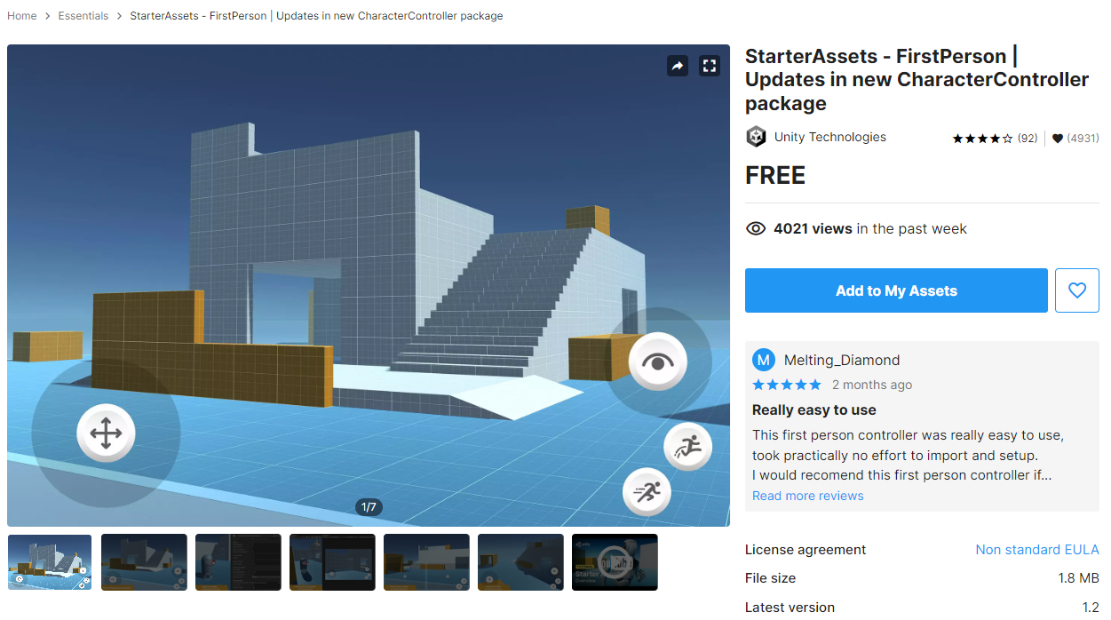
3D Interactive Media Development
Unity Camera Prefabs - Unity Starter Assets
Prefabs are already used in the demo Unity project, but Starter Asset Package is not there
If you want to use it:
Import Unity Starter Assets packages: https://assetstore.unity.com/packages/essentials/starter-assets-thirdperson-updates-in-new-charactercontroller-pa-196526 https://assetstore.unity.com/packages/essentials/starterassets-firstperson-updates-in-new-charactercontroller-pac-196525

Slide 10
3D Interactive Media Development
Unity Camera Controllers – 3PC, FPC
https://www.youtube.com/watch?v=dXzF-S9tVrM
Unity Project Scenes - Standard Assets non URP: 3PC, FPC
1. Create new scene
2. Import Unity Standard Assets package/Characters from https://jimmyvegas.itch.io/standard-assets
Assets/Import Package/Custom Package/select downloaded “Standard Assets for Unity 20184.unitypackage”
You may need to change “UI.Text” to “UnityEngine.UI.Text” in 1 or 2 scripts with an error message
3. Import all
4. In Project window go to:
Standard Assets/Characters/Third Person Character/Prefabs/ThirdPersonController or FirstPersonController
5. Drag into hierarchy
6. Create and zero out plane - Run and use mouselook and arrows to navigate
Create GameObject/3D Object/Plane
3PC or FPC character: Drag down below prefab - 0,0,0
7. When Creating your own 3PC or FPC:
Position Main Camera to frame target/player
Drag Main Camera into 3PC or FPC as Child

Slide 11
3D Interactive Media Development
Unity Camera Controllers – 3PC, FPC
https://www.youtube.com/watch?v=dXzF-S9tVrM
Unity Project Scenes - Starter Assets URP: 3PC, FPC
1. Create new scene
2. Import Unity Standard Assets package/Characters from https://assetstore.unity.com/packages/package/267961
3. Import all
4. In Scene drag in Prefabs from Package:
FPC: NestedParent_Unpack Prefab in scene
3PC: Tool menu at top: reset player armature, controller capsule
5. URP is Basic, will need to set up post processing volume (tutorial sheet next week)

Slide 12
3D Interactive Media Development
Unity Camera Controllers - 3PC
https://www.youtube.com/watch?v=dXzF-S9tVrM
Unity Project Scenes – Starter Assets: 3PC, FPC
Has:
Navmesh AI (uneeded)
Rigidbody
Capsule Collider
3 Person Control
Character with animator
Must Add Camera:
Adjust view
Parent camera to 3PC
Add colliders around desired scene to limit the navigation:
(Setting up Play Area)
https://unity3d.com/learn/tutorials/projects/roll-ball-tutorial/setting-play-area?playlist=17141

Slide 13
3D Interactive Media Development
Unity Camera Controllers – Other Scripts
Unity Project Scenes:
SmoothFollow
Freelook
Waypoint with Mouse Orbit
RTS - Real Time Strategy Camera Controllers
Diorama (follows player in 2.5D)
Camera Switcher

Slide 14
3D Interactive Media Development
Exercise: Unity SmoothFollow and SmoothDamp Camera (Good for following Player Character from behind)
https://docs.unity3d.com/ScriptReference/Vector3.SmoothDamp.html
New 3D Scene, Add Cube and Plane, Add camera code to camera, use cube as target
public class EcameraSmoothFollow : MonoBehaviour
{
public Transform target;
public float smoothTime = 0.3F;
private Vector3 velocity = Vector3.zero;
void Update()
{
// Define a target position above and behind the target transform
Vector3 targetPosition = target.TransformPoint(new Vector3(0, 1, -10));
// Smoothly move the camera towards that target position
transform.position = Vector3.SmoothDamp(transform.position, targetPosition, ref velocity, smoothTime);
}
}

Slide 15
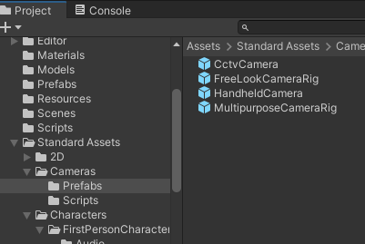
3D Interactive Media Development
Unity Camera Prefabs – FreeLook (Similar to Whitevoid)
http://www.whitevoid.com/#/main
Unity Project Scenes - Starter Assets: 3PC, FPC, FreeLook
In Project window go to:
Standard Assets/Cameras/Prefabs/FreeLookCameraRig
Drag into hierarchy
Create GameObject/3D Object/Cube/
Tag as Player
Delete Main Camera

Slide 16
3D Interactive Media Development
Unity Camera Prefabs – FreeLook (Like Web mouse rotation)
Unity Project Scenes – Starter/Standard Assets: 3PC, FPC, FreeLook
The "Free Look" camera is designed to follow a target's position, while allowing the user to rotate the angle of the camera with the mouse (or a touch gesture). With the "Free Look" camera, the rig is designed so the root object of the rig should always look towards the target's position. The camera offset is specified by the height (the Y value) of the "Pivot" object, and the forward offset of the final "Camera" object. The camera lerps to the view position.
A typical set up for this would be to have the Y positional value of the Pivot set to 2 (for 2 meters above the target), and the Z positional value of the Camera set to -6 (for 6 meters behind the pivot).
If you wanted to adjust the camera to be to one side of the target (eg, for a closer over-shoulder third person view), you should adjust the X position value of the Pivot object.
Camera Rig<- position will move towards target.
Pivot<- adjust Y position for height, X position for horizontal offset
Camera<- adjust Z position for distance away from target

Slide 17
3D Interactive Media Development
Unity Camera Controllers - Waypoint and MouseOrbit
Unity Project Scenes:
Waypoint with Mouse Orbit

Slide 18
3D Interactive Media Development
Unity Camera Controllers - Waypoint and MouseOrbit
Unity Project Scenes: Waypoint with Mouse Orbit
Object Selection – Waypoints
Mouse Orbit – Around Waypoints with Focus
Focus – Camera Focus on GameObject

Slide 19
3D Interactive Media Development
Unity Camera Controllers
Unity Project Scenes: Waypoint with Mouse Orbit
Camera Waypoint Examples
https://www.youtube.com/watch?v=8HALMRhbpGI
http://forum.unity3d.com/threads/camera-frame-selected-how-to.7308/
Transform look at
https://docs.unity3d.com/2020.1/Documentation/ScriptReference/Transform.LookAt.html
http://answers.unity3d.com/questions/891120/framing-an-object-bounds-encapsulating.html
Selection.activeGameObject = yourObject; SceneView.FrameLastActiveSceneView();
Maybe Camera.WorldToViewportPoint andCamera.ViewportToScreenPoint will come in handy.
Simple scripts

Slide 20
3D Interactive Media Development
Unity Camera Controllers – Some basic Scripts to try
Unity Project Scenes: Waypoint with Mouse Orbit
Camera Waypoint Script
Pasted from <http://answers.unity3d.com/questions/891120/framing-an-object-bounds-encapsulating.html>
On your main camera:
public void Focus(Transform target, float offset)
{
Vector3 direction = transform.position - target.position;
direction = offset * direction.normalized;
Vector3 moveTo = target.position + direction;
transform.position = new Vector3(moveTo.x, 3f, moveTo.z);
transform.LookAt(target);
}

Slide 21
3D Interactive Media Development
Unity Camera Controllers – Some basic Scripts to try
Unity Project Scenes: Waypoint with Mouse Orbit
Camera Waypoint Script
Pasted from <http://answers.unity3d.com/questions/891120/framing-an-object-bounds-encapsulating.html>
On your GameObject:
float offset = 4.24264f
void OnMouseOver()
{
if (Input.GetMouseButtonDown(0))
{
Camera.main.GetComponent<FocusScript>().Focus(transform, offset);
}
}

Slide 22
3D Interactive Media Development
Unity Camera Controllers – Some basic Scripts to try
Unity Project Scenes: Waypoint with Mouse Orbit
Mouse Camera Orbit Improved (MOI) Examples:
Camera rotates around object selected and mouse orbited
http://stackoverflow.com/questions/34117591/c-sharp-with-unity-3d-how-do-i-make-a-camera-move-around-an-object-when-user-mo
Mouse Orbit
http://wiki.unity3d.com/index.php?title=MouseOrbitImproved#Code_C.23
Mouse Orbit Zoom
http://wiki.unity3d.com/index.php/MouseOrbitZoom
Cursor Lock
Press key to turn mouse orbit on and off - modify

Slide 23
3D Interactive Media Development
Unity Camera Controllers – RTS Camera Movement
Unity Project Scenes: Real Time Strategy Cameras
Mouse input movement similar to real time strategy games.
The input translates the mouse 2D screen position into 2.5D or 3D camera movement.
See Unity Project (Camera Demos SA) Scene and Code

Slide 24
3D Interactive Media Development
Unity Camera Controllers – RTS Position
Unity Project Scenes: Real Time Strategy Cameras
Mouse RTS Position – Basic with RMB (RightMouseButton)
http://coffeebreakcodes.com/camera-movement-with-mouse-unity3d-c/
Mouse screen position translates camera when RMB pressed
Inside screen
Very basic
Uses principles we looked at above and in previous lectures and tutorials
Input.GetMouse Button
Input.GetAxis
Transform
Vector3
Time.DeltaTime

Slide 25
3D Interactive Media Development
Unity Camera Controllers – RTS Position
Unity Project Scenes: Real Time Strategy Cameras
Mouse RTS Position – Basic with RMB (RightMouseButton)
http://coffeebreakcodes.com/camera-movement-with-mouse-unity3d-c/
if (Input.GetMouseButton (1)) {
if (Input.GetAxis ("Mouse X") > 0) {
transform.position += new Vector3 (Input.GetAxisRaw ("Mouse X") * Time.deltaTime * speed,
0.0f, Input.GetAxisRaw ("Mouse Y") * Time.deltaTime * speed);
}
else if (Input.GetAxis ("Mouse X") < 0) {
transform.position += new Vector3 (Input.GetAxisRaw ("Mouse X") * Time.deltaTime * speed,
0.0f, Input.GetAxisRaw ("Mouse Y") * Time.deltaTime * speed);
}
}
}

Slide 26
3D Interactive Media Development
Unity Camera Controllers– RTS Position
Unity Project Scenes: Real Time Strategy Cameras
Mouse RTS Position – Mouse 2D Out Screen Drag
http://coffeebreakcodes.com/camera-movement-with-mouse-unity3d-c/
Mouse screen position translates camera – Script on Camera
Outside screen
Inside screen (1/2 code)

Slide 27
3D Interactive Media Development
float speed = 10.0f;
int boundary = 1;
int width;
int height;
void Start ()
{
width = Screen.width;
height = Screen.height;
}
void Update ()
{
if (Input.mousePosition.x > width - boundary)
{ transform.position -= new Vector3 (Input.GetAxisRaw ("Mouse X") * Time.deltaTime * speed, 0.0f, 0.0f); }
if (Input.mousePosition.x < 0 + boundary)
{ transform.position -= new Vector3 (Input.GetAxisRaw ("Mouse X") * Time.deltaTime * speed, 0.0f, 0.0f); }
if (Input.mousePosition.y > height - boundary)
{ transform.position -= new Vector3 (0.0f, 0.0f, Input.GetAxisRaw ("Mouse Y") * Time.deltaTime * speed); }
if (Input.mousePosition.y < 0 + boundary)
{ transform.position -= new Vector3 (0.0f, 0.0f, Input.GetAxisRaw ("Mouse Y") * Time.deltaTime * speed); }
}

Slide 28
3D Interactive Media Development
Unity Camera Controllers– RTS Position Live Input
Unity Project Scenes: Real Time Strategy Cameras
Mouse RTS Position – Mouse 2D In Screen Drag
http://coffeebreakcodes.com/camera-movement-with-mouse-unity3d-c/
Mouse screen position translates camera – Script on Camera
Outside screen
Inside screen (½ code)

Slide 29
3D Interactive Media Development
float speed = 10.0f;
int boundary = 1;
int width;
int height;
void Start ()
{
width = Screen.width;
height = Screen.height;
}
void Update ()
{
if (Input.mousePosition.x > (width/2) )
{ transform.position -= new Vector3 (Input.GetAxisRaw ("Mouse X") * Time.deltaTime * speed, 0.0f, 0.0f); }
if (Input.mousePosition.x < (width/2) )
{ transform.position -= new Vector3 (Input.GetAxisRaw ("Mouse X") * Time.deltaTime * speed, 0.0f, 0.0f); }
if (Input.mousePosition.y > (height/2) )
{ transform.position -= new Vector3 (0.0f, 0.0f, Input.GetAxisRaw ("Mouse Y") * Time.deltaTime * speed); }
if (Input.mousePosition.y < (height/2) )
{ transform.position -= new Vector3 (0.0f, 0.0f, Input.GetAxisRaw ("Mouse Y") * Time.deltaTime * speed); }
}

Slide 30
3D Interactive Media Development
Unity Camera Controllers – RTS Rotation Live Input
Mouse RTS Rotation
Mouse screen position rotates camera
This does not have focus for target, we will use other code instead.
Mouse Orbit and waypoint

Slide 31
3D Interactive Media Development
Unity Camera Controllers - 2.5D Diorama Style
Unity Project Scenes - Noor5 and Rollerball

Slide 32
3D Interactive Media Development
Unity 2.5D Camera – Diorama
Unity Project Scenes: Diorama - Noor5 and Rollerball
Example: https://www.youtube.com/watch?v=CvEMvYUXxaE https://learn.unity.com/project/roll-a-ball
Noorcon Inc. - Unity 3D Game Programming Part 5 - Vahe Karamian
Camera with transparent player controlled by input keys
(Parented, constrained by script, or constrained by Unity “Align with View”)
Collider boxes for lockdown
Similar to Rollerball tutorial

Slide 33
3D Interactive Media Development
Unity 2.5D Camera – Diorama Tutorial with Player object and Aligned Camera
Unity Project Scenes: Diorama - Noor5 and Rollerball
Noorcon Inc. - Unity 3D Game Programming Part 5 - Vahe Karamian
Create Gameobject (Player):
Add Rigidbody (Physics, Gravity)
Freeze rotation on X and Z
Unity Project Scenes - Noor5 and Rollerball

Slide 34
3D Interactive Media Development
Unity 2.5D Camera – Diorama Tutorial with Player object and Aligned Camera
Noorcon Inc. - Unity 3D Game Programming Part 5 - Vahe Karamian
Add Script to Player GameObject:
using UnityEngine; using System.Collections;
public class playerInput : MonoBehaviour {
// Use this for initialization void Start () { } // Update is called once per frame void Update () { // code for the movement of player (CP) forward if(Input.GetKey(KeyCode.UpArrow)){ this.transform.Translate(Vector3.forward * Time.deltaTime); } // code for the movement of player (CP) backward if(Input.GetKey(KeyCode.DownArrow)){ this.transform.Translate(Vector3.back * Time.deltaTime); } // code for the movement of player (CP) left if(Input.GetKey(KeyCode.LeftArrow)){ this.transform.Translate(Vector3.right, -5); } // code for the movement of player (CP) right if(Input.GetKey(KeyCode.RightArrow)){ this.transform.Translate(Vector3.right, 5); } }

Slide 35
3D Interactive Media Development
Unity 2.5D Camera – Diorama Tutorial with Player object and Aligned Camera
Unity Project Scenes: Diorama - Noor5 and Rollerball
Noorcon Inc. - Unity 3D Game Programming Part 5 - Vahe Karamian In Scene Window:
Create GameObject/3D Object/Plane
Drag down below prefab in Scene – this is so the Player Controller does not drop through the scene.
Position Main Camera to frame object and scene
Make sure your boundaries (Planes? Lego?) have colliders on
In Scene Window:
In the scene window, use your mouse to position your view in the behind the Player. When you are satisfied with what you see in the Scene Window, select the Main CameraObject. From the main menu, select GameObject-> Align With View. This will move the Main Camera GameObject, or the current selected GameObject, to be aligned with the view in the scene
Run with Play key at top and use key input to move about and see result

Slide 36
3D Interactive Media Development
Unity 2.5D Camera – Diorama Tutorial with Player object and Aligned Camera
Unity Project Scenes: Diorama - Noor5 and Rollerball
Noorcon Inc. - Unity 3D Game Programming Part 5 - Vahe Karamian
Add Static Colliders:
Make sure walls or lego cubes constraining diorama have colliders to stop object
Make Player Controller Transparent or Small
In the scene, use your mouse to position your view behind the CP, the Sphere. When you are satisfied with what you see in the Scene Window, select the MainCamera object. From the main menu, select GameObject->Alighn With View. This will move the Main Camera GameObject, or the current selected GameObject, to be aligned with the view in the scene!
Adjust as needed, Run with Play key at top and use key input to move about and see result

Slide 37
3D Interactive Media Development
Unity 2.5D Camera – Camera Switcher
Unity Project Scenes: Camera Switcher
Works with all previous cameras!
Try this and experiment – move objects with cameras attached and switch to them, use triggered animations and lerps….

Slide 38
3D Interactive Media Development
Exercise: Unity 3D Camera- Waypoints and mouse orbits Example: 100,000 Stars http://stars.chromeexperiments.com/ In Camera Demos Unity Project
Has mouse orbit with no limits
Can have Boolean for game object framed
Right Mouse Button goes Back to Start Object
Esc key deactivates Mouse orbit deactivate
(for easier mouse cursor selection)
Notes:
https://www.youtube.com/watch?v=-5RiMoILHTA
https://forum.unity3d.com/threads/fly-move-camera-object-to-waypoint-with-button-click.46988/

Slide 39
3D Interactive Media Development
Exercise: Unity 2.5D Camera – FreeLook Camera (Limited mouse orbit – Whitevoid – Outside In)
Freelook in Camera Demos Unity Project – Add camera moves
Mouse orbit by 2D screen mapping
(adjust limits)
2. Add Camera Focus to GameObject
(try swapping targets)
3. Or use Lerp, Movetowards, Translate, or Animations triggered
(move camera, script settings, or new focus as above)

Slide 40
3D Interactive Media Development
Exercise: Animation Trigger Waypoints
Position Changes (Animated)
Camera Animations for movement
Rotation (Inside Out)
Camera MouseLook Script or RTS Middledrag (rotation)

Slide 41
3D Interactive Media Development
Exercise: Movement Scripted Free Waypoints
Position Changes (Scripted)
Code from Lego Bricks Tutorial 03
Try some more advanced code – Vector3, movetowards, Lerp
Rotation (Inside Out)
Camera MouseLook Script or RTS Middledrag (rotation)

Slide 42
3D Interactive Media Development
LERP Reference
https://gamedevbeginner.com/the-right-way-to-lerp-in-unity-with-examples/
https://youtu.be/RNccTrsgO9g
https://gamedevbeginner.com/coroutines-in-unity-when-and-how-to-use-them/
https://youtu.be/kUP6OK36nrM

Slide 43
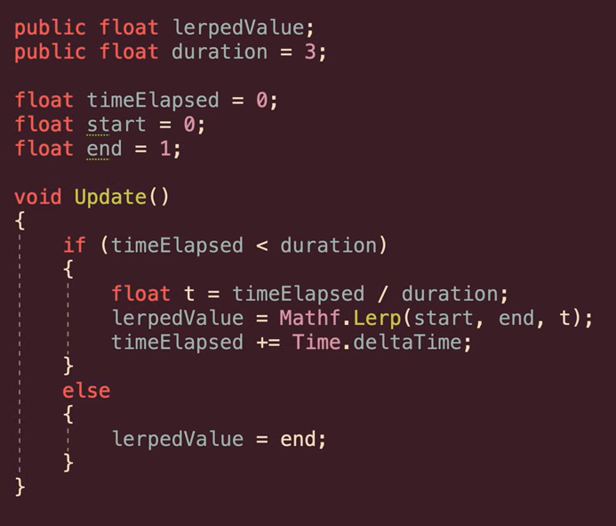
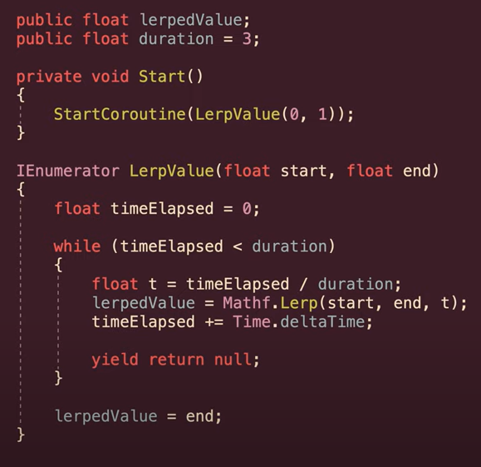
3D Interactive Media Development
LERP Reference
Good: Linear Move "from – to" in period of time
1. Defined start end and duration
2. Elapsed time divided by duration
3. Checks for elapsed=duration to snap to end
4. Usually put in a coroutine

Slide 44
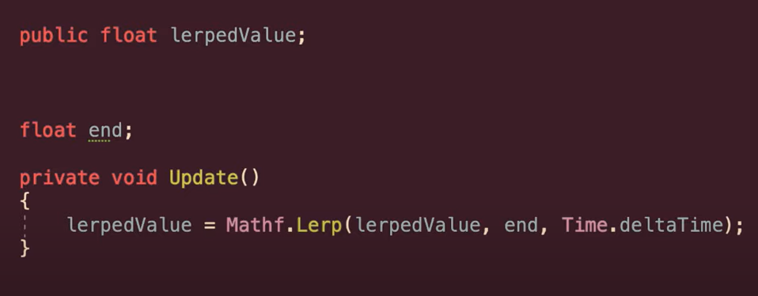
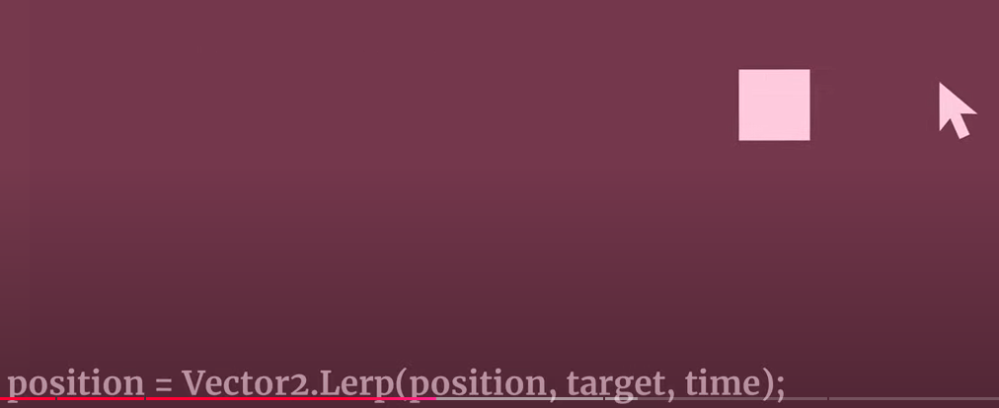
3D Interactive Media Development
LERP Reference
"Bad": Dynamic easing method -
constantly moved to changing target
1. Use current target as minimum lerp value
2. Maximum lerp is moving target (passed in)
3. T = Time.deltaTime
4. Constantly update as fractionally closer to target.
5. Change gets smaller - incorrect ease - can snap though
6. Also rate of change is not scaled

Slide 45
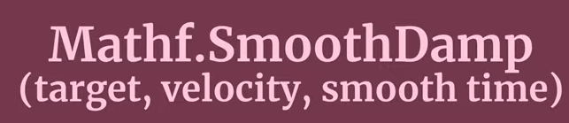
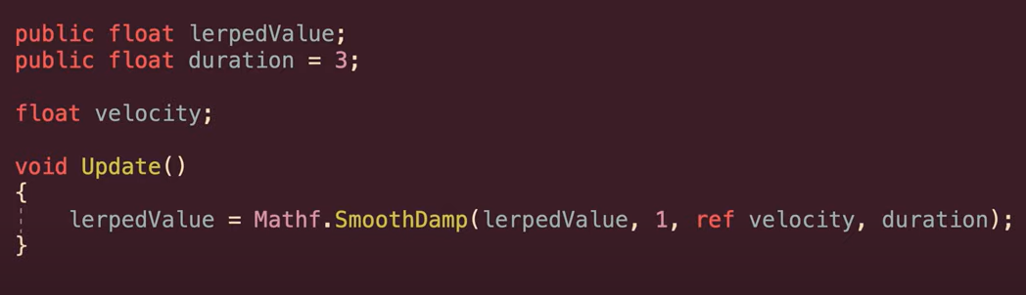
3D Interactive Media Development
LERP Reference
SmoothDamp is preferred
Smoothly move towards a dynamic target
over approx amount of time.
Beginning and end will be slowed
Clamped?
Good for follow camera
Current velocity
How fast changing
Remaining distance to target
In CameraSmoothFloow Example in "Camera Demos SA" Project

Slide 46
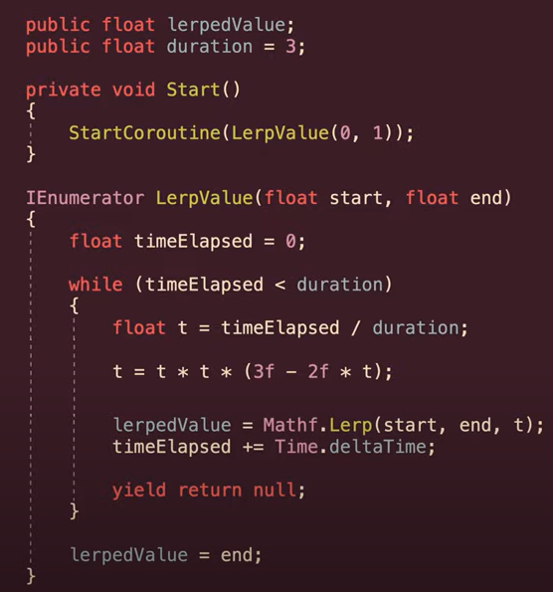
3D Interactive Media Development
LERP Reference
Lerp with fixed time scale and curve
(ease in and out)

Slide 47
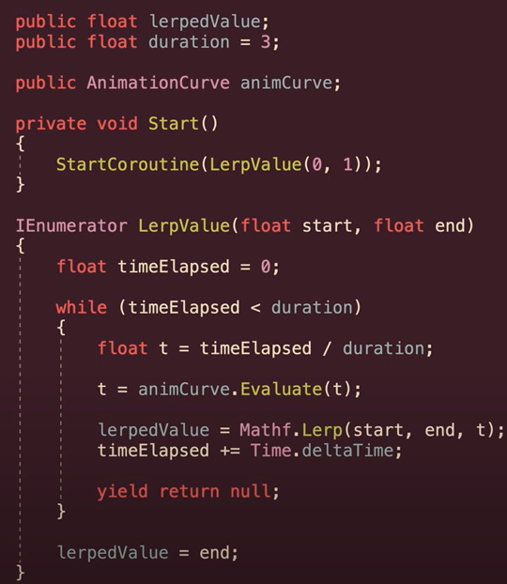
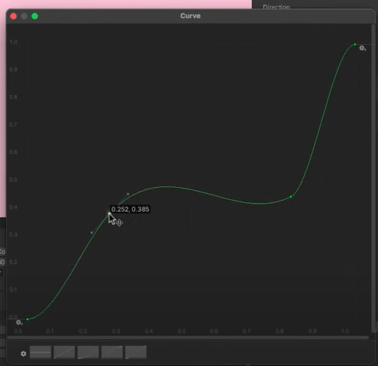
3D Interactive Media Development
LERP Reference
Or pass in normalised animation curve

Slide 48
3D Interactive Media Development
ClickLerp: New camera position by keypress, Mouse click
function OnMouseEnter() {
transform.position = Vector3.Lerp(this.transform.position, new Vector3(0.0512155,0.5632893,5.466473), 0.2);
}
The parameters that Vector3.Lerp as also the Vector3.MoveTowards require are the following:
1 parameter is the actual position
2 parameter is the position that you want to move to
3 parameter is the time to move from the actual position to the final position.
Easier to Animate Camera!
Notes:
https://stackoverflow.com/questions/61417584/unity-player-controller-not-moving-toward-mouse-cursor

Slide 49
3D Interactive Media Development
ClickLerp: New camera position by keypress, Mouse
public class ClickLerp : MonoBehaviour {
//Code From: https://answers.unity.com/questions/1613407/how-to-use-smoothly-move-camera-to-position-using.html
public Transform camPos;
public float CamMoveSpeed = 5f;
Vector3 camNewPos;
private void Start() {camNewPos = camPos.position;}
private void Update() {
if (Input.GetMouseButton(0)) {
float xinput = Input.GetAxisRaw("Mouse X");
float zinput = Input.GetAxisRaw("Mouse Y");
float x = camPos.position.x;
float z = camPos.position.z;
float y = camPos.position.y;
camNewPos = new Vector3(x + xinput, y, z + zinput);}
//camPos.position = Vector3.MoveTowards(camPos.position, camNewPos, CamMoveSpeed * Time.deltaTime);
camPos.position = Vector3.Lerp(camPos.position, camNewPos, CamMoveSpeed * Time.deltaTime);
}
}
Notes:
https://stackoverflow.com/questions/61417584/unity-player-controller-not-moving-toward-mouse-cursor

Slide 50
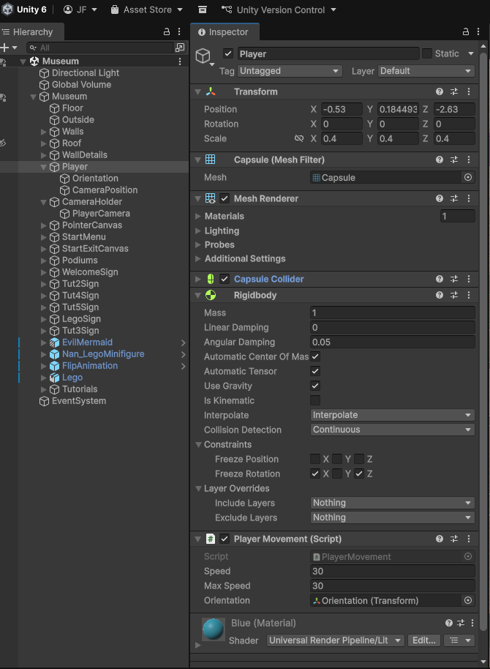
3D Interactive Media Development
Lego Museum Camera System
Player Game Object
PlayerMovement.cs
1.Creates public variable type Transform called Orientation Populates with the Orientation Game Object which is its child
PlayerCam.cs updates the Orientation, which is used by this script
2. Takes in Horizontal and Vertical Input:
horizontalInput = Input.GetAxisRaw("Horizontal");
verticalInput = Input.GetAxisRaw("Vertical");
3. Performs FixedUpdate on RigidBody on Player Game Object with
position and orientation input
//movement based on orientation which in specific object
moveDirection = orientation.forward * verticalInput + orientation.right * horizontalInput;
rb.linearDamping = (speed / maxSpeed); //used to be drag, not sure if it has an impact
rb.AddForce(moveDirection.normalized * speed, ForceMode.Force);
https://gyazo.com/dbe0b0326cae37bb7fc7c1eda36fc6eb
Notes:
https://stackoverflow.com/questions/61417584/unity-player-controller-not-moving-toward-mouse-cursor

Slide 51
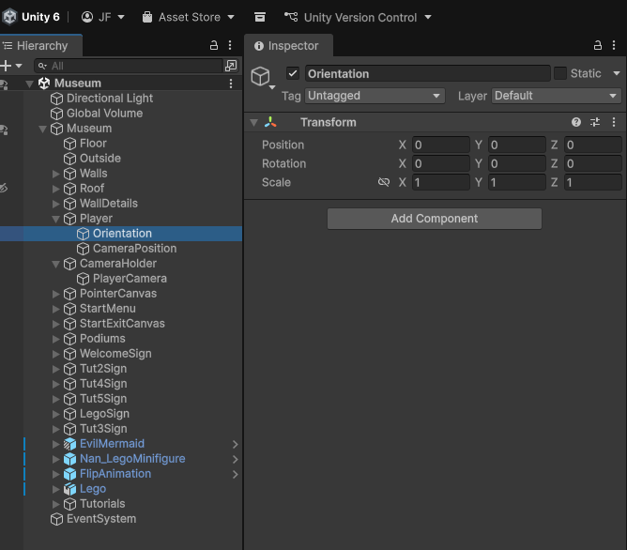
3D Interactive Media Development
Lego Museum Camera System
Player Game Object
Orientation Game Object
https://gyazo.com/11999acc16880e7cb1a5f0cd6a9d42c9
Notes:
https://stackoverflow.com/questions/61417584/unity-player-controller-not-moving-toward-mouse-cursor

Slide 52
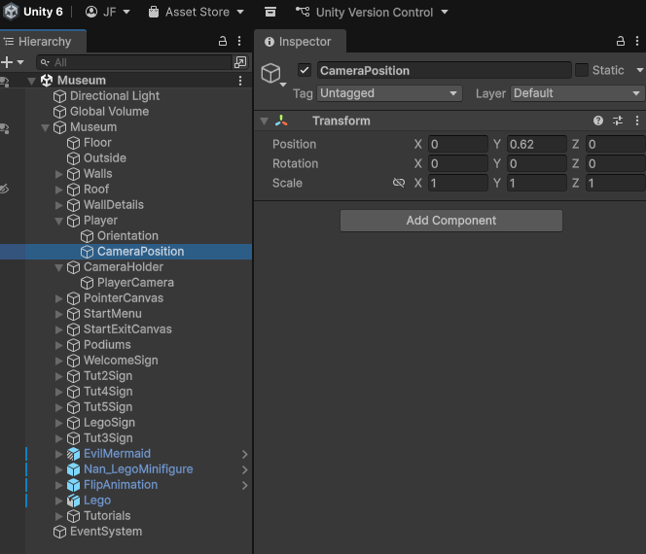
3D Interactive Media Development
Lego Museum Camera System
Player Game Object
Camera Position Game Object
https://gyazo.com/ce67e7808baddeecad77d55ef3ea2ad2
Notes:
https://stackoverflow.com/questions/61417584/unity-player-controller-not-moving-toward-mouse-cursor

Slide 53
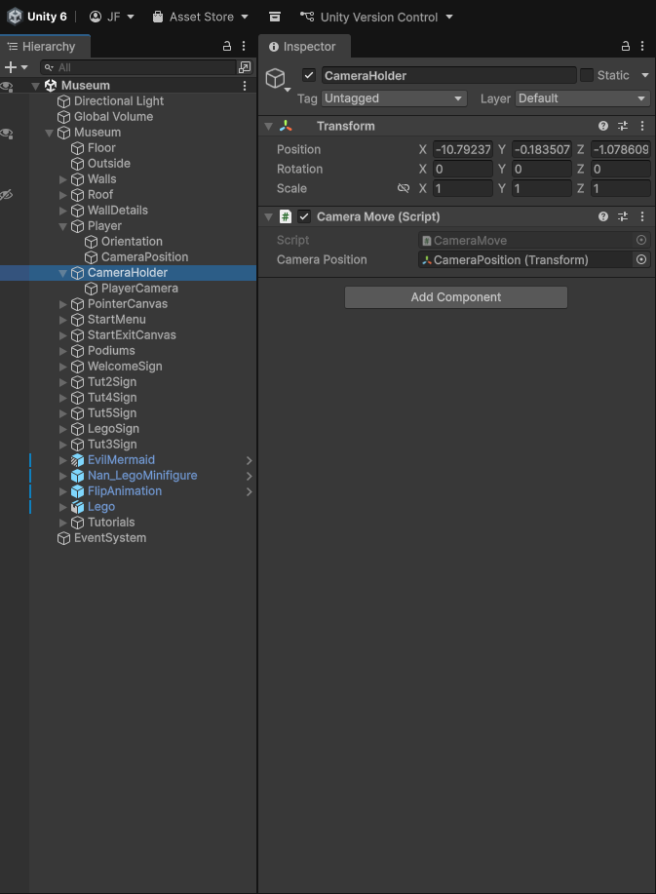
3D Interactive Media Development
Lego Museum Camera System
Camera Holder Game Object
CameraMove.cs
1.CameraPosition GameObject child of Player GameObject is followed
for transform position
2. This handles the position via PlayerGO/PlayerMovement.cs RigidBody
controller script
3. This allows the PlayerCam.cs on the PlayerCamera GO to handle the
orientation
https://gyazo.com/e1810339c3985cc0e137597b4569f9b2
Notes:
https://stackoverflow.com/questions/61417584/unity-player-controller-not-moving-toward-mouse-cursor

Slide 54
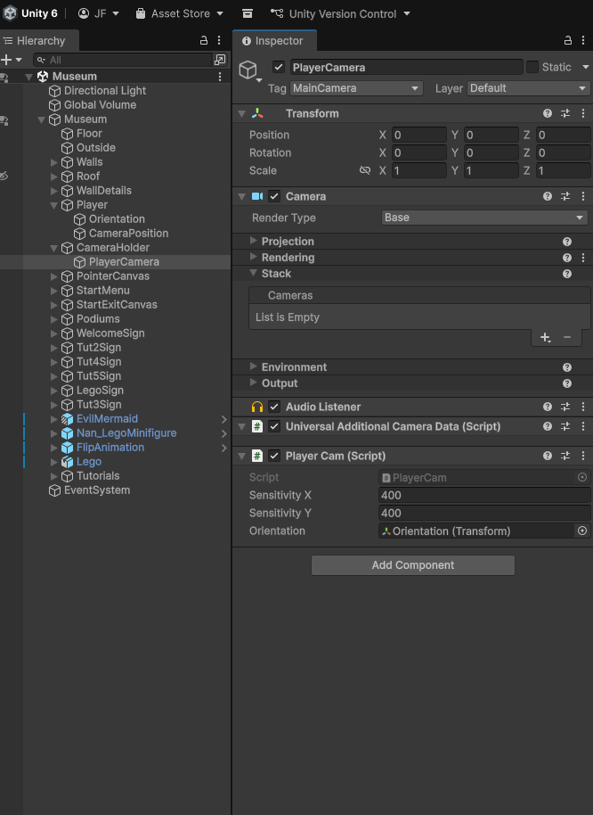
3D Interactive Media Development
Lego Museum Camera System
Camera Holder Game Object
PlayerCamera Game Object PlayerCam.cs
1.Mouse-look controller - Reads mouse X/Y, applies sensitivities and Time.deltaTime, clamps pitch, updates camera rotation.
2. Writes yaw to a public Transform variable called "orientation" which
Updates the Orientation GO child of the Player GO (orientation.rotation = Quaternion.Euler(0, yrotation, 0)) so movement aligns with camera yaw.
Note: its cursor-locking startup code is commented out; cursor state is handled elsewhere.
https://gyazo.com/ce67e7808baddeecad77d55ef3ea2ad2
Notes:
https://stackoverflow.com/questions/61417584/unity-player-controller-not-moving-toward-mouse-cursor

Slide 55
3D Interactive Media Development
Case 04 Unity 2.5D Camera – Position State Changes (Tap to move camera – TGC, Krak, Sniper(FPS) )
New camera position by keypress
Move Camera to new Vector3 Postion, Keep Orbit Options (Code to Come)
Sniper (complex with FPS, at 12:00 on)
Unity 3D Tutorial Third Person Shooter part 2 The Aiming [Outdated]
New camera position by screen tap
Raycast and Lerp (Complex with 3PC, TGC)
http://www.thegamecontriver.com/2014/10/move-to-mouse-click-touch-position-unity.html
Notes:
private Vector2 destination;
public float MoveSpeed;
void Update()
{
if (Input.GetMouseButtonDown(0))
{
destination = Camera.main.ScreenToWorldPoint(Input.mousePosition);
transform.DOMove(destination, MoveSpeed).SetEase(Ease.Linear);
}
}

